Slide 1
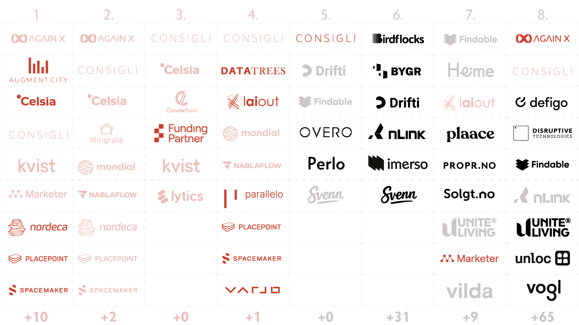

Slide 6
Notes:
So what did our data collection consist of?
Firstly – we get the user-perspective
Dev, consultants, authorities, citizens..
goals and struggles, time-consuming tasks…
Secondly – strategic sample of 154 cases – answering users’ needs…
Company background, and area of application…

Slide 7
Notes:
Due to time restriction and sample size,
we are taking the cases on face value…
We were geographically limited –
Oslo centric: potentially proptech cases flying under the radar (NTNU is a great example!).
(PPC)Company centric: one of our key findings are actually beyond our scope (customised modules).
10 years timeframe poses limited perspective of what actually is!

Slide 8
Notes:
So basically,
How we understand proptech
Is that directly responds to the core business practices in property dev.
Supposedly:
RED Early stage: entrepreneurial/visionary part…
BLACK late stage: important decisions already made =
Hence, limited opportunities in affecting built environment.

Slide 9
Notes:
So, basically when 85% of all PPC in one way or the other in the later stages,
We ask the question if
the allocation of the industry’s capacity and resources are well-placed?
There are many activities in the earlier stages requiring digital attention…

Slide 10
Notes:
From our study, we characterise 4 main categories
Then in the end,
we do want to present two categories outside our scope....

Slide 11
Notes:
So, what are the tendencies in the market majority?
Well, you have everything from
SVENN – automating/simplifying documentation for craftsmen!
MARKETER – reinventing online marketplace for house/CRE
IMERSO – Digital twin/real time risk assessment…
DEFIGO – SaaS - digital keys (not standardised yet)…

Slide 12
Notes:
Pure FM/MOM is somewhat variations of the same proptech proposition:
The philosophy of every piece of office/home
can be/Should be technologically fueled!
SOUNDSENSING – digital error testing through sound...
DISR.TECH – digitally informed by sensor on doors, chairs, desks…
UNLOC – digitalise the doorbell, keys...
DEFIGO – digitalising doorbell/keys – part II
Roy on the countryside – smart gutters...

Slide 13
Notes:
HYBRIDS – this is some PPC answers both late AND early stage within same tool...
Feedback loop between late- to early stage..
There are a volume of FM data that are being repurposed to early stage proptech…
Reinforming neighbourhoods, property potential, future yield etc.
Why is this important for FM research?
Well, it basically debunks the idea that early stage
as the only one being visionary/entrepreneurial...

Slide 14
Notes:
Two dominant tendencies..
Not important for this conference.

Slide 15
Notes:
Categories that fell outside our scope
and deserves a special mention:
outliers – powergrids, snowbrushers on cables, reuse marketplaces...
These are tools that wouldn’t exist ten years ago...
Had it not been the current pressure on being responsible and sustainable
Customised modules – made because PPC
are not quick enough to address project specific case or complexity...
Made by consultants...

